Slide 1


Alffredi Ramos
06/05/2022

Slide 2
Outline
Executive Summary
Introduction
Methodology
Results
Conclusion
Appendix

Slide 3

Executive Summary
Summary of methodologies
Data Collection
Webscraping
Data Wrangling
EDA with SQL
EDA with Data Visualization
Interactive Visual Analytics with Folium
Predictive Analysis
Summary of all results
EDA Results
Interactive Analytics
Predictive Analysis

Slide 4
Project background and context
Space X advertises Falcon 9 rocket launches on its website for a cost of 62 million dollars. On the other hand, other providers can cost an upward of 165 million dollars each. Much of the cost difference is because Space X can reuse the first-stage. If we can determine if the first stage will land successfully, we can determine the cost of a launch. We can then use this information incase an alternate company wants to bid against space X for a rocket launch. Ultimately, the goal of this project is to create a machine learning pipeline to predict if the first stage will land successfully after a launch.
Problems you want to find answers
What operating conditions needs to be in place to ensure a successful landing program?
What factors determine if the Falcon 9 rocket will land successfully?
Introduction

Slide 5

Section 1

Slide 6
Methodology
Executive Summary
Data collection methodology:
SpaceX API, webscraping from Wikipedia.
Perform data wrangling
One-Hot Encoding for Machine Learning and Data Cleaning of null values and irrelevant columns of data.
Perform exploratory data analysis (EDA) using visualization and SQL
Perform interactive visual analytics using Folium and Plotly Dash
Perform predictive analysis using classification models
LR, KNN, SVR, DT models for best classifier

Slide 7
Data Collection
Describe how data sets were collected.
Data collection was done using get request to the SpaceX API.
Next, we decoded the response content as a Json using .json() function call and turn it into a pandas dataframe using .json_normalize().
We then cleaned the data, checked for missing values and fill in missing values where necessary.
In addition, we performed web scraping from Wikipedia for Falcon 9 launch records with BeautifulSoup.
The objective was to extract the launch records as HTML table, parse the table and convert it to a pandas dataframe for future analysis.

Slide 8
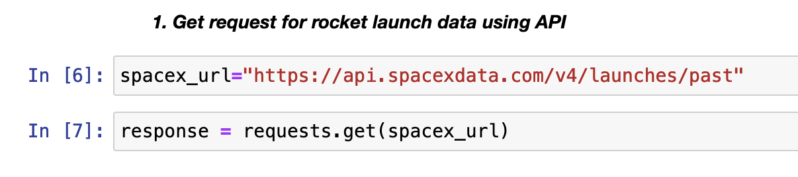
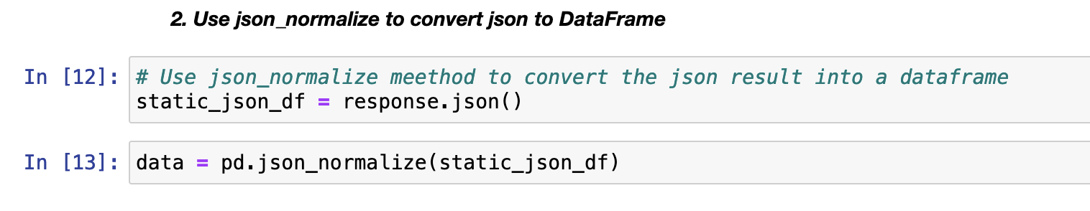
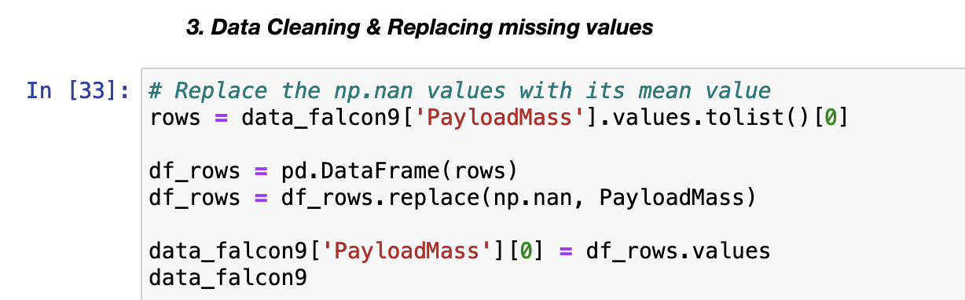
Data Collection – SpaceX API
We used the get request to the SpaceX API to collect data, cleaned the requested data and did some basic data wrangling and formatting, as well as replacing missing/nan values.
The Link to the Notebook: https://github.com/FreddyR424/Capstone-Project-SpaceX/blob/master/jupyter-labs-spacex-data-collection-api(1).ipynb
Place your flowchart of SpaceX API calls here

Slide 9
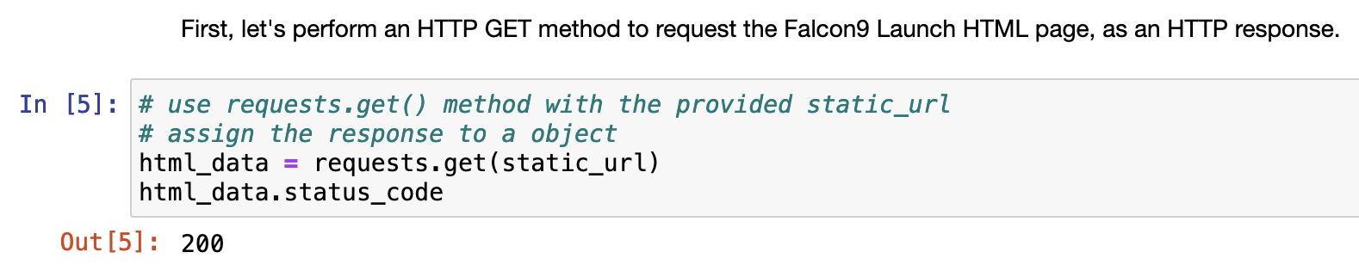
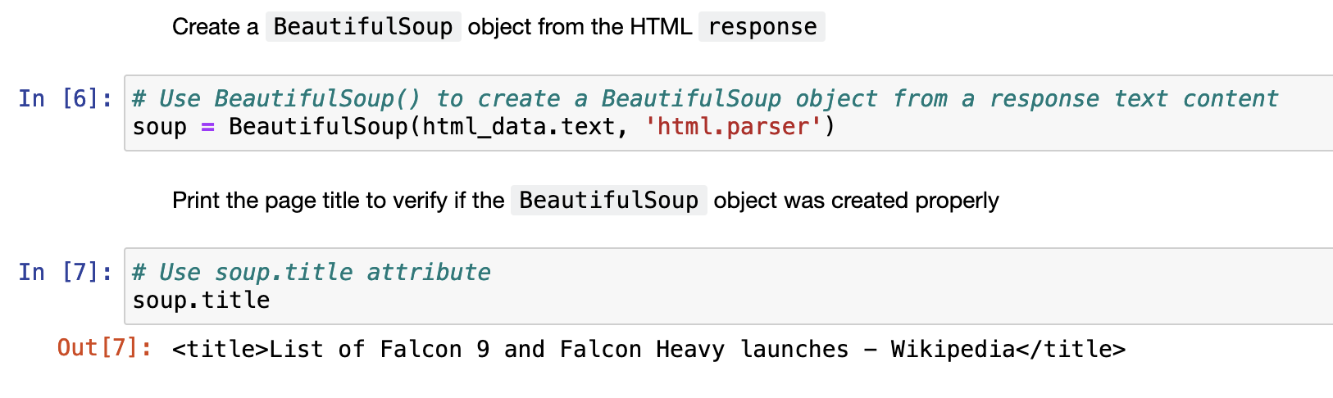
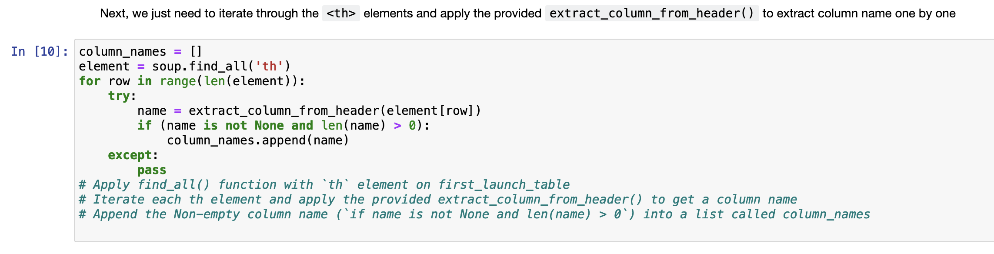
Data Collection - Scraping
We applied web scrapping to webscrap Falcon 9 launch records with BeautifulSoup
We parsed the table and converted it into a pandas dataframe.
The Link to the Notebook: https://github.com/FreddyR424/Capstone-Project-SpaceX/blob/master/jupyter-labs-webscraping(1).ipynb
Place your flowchart of web scraping here

Slide 10

Data Wrangling
We performed exploratory data analysis and determined the training labels.
We calculated the number of launches at each site, and the number and occurrence of each orbits
We created landing outcome label from outcome column and exported the results to csv.
The link to the notebook is https://github.com/FreddyR424/Capstone-Project-SpaceX/blob/master/labs-jupyter-spacex-Data%20wrangling(1).ipynb

Slide 11
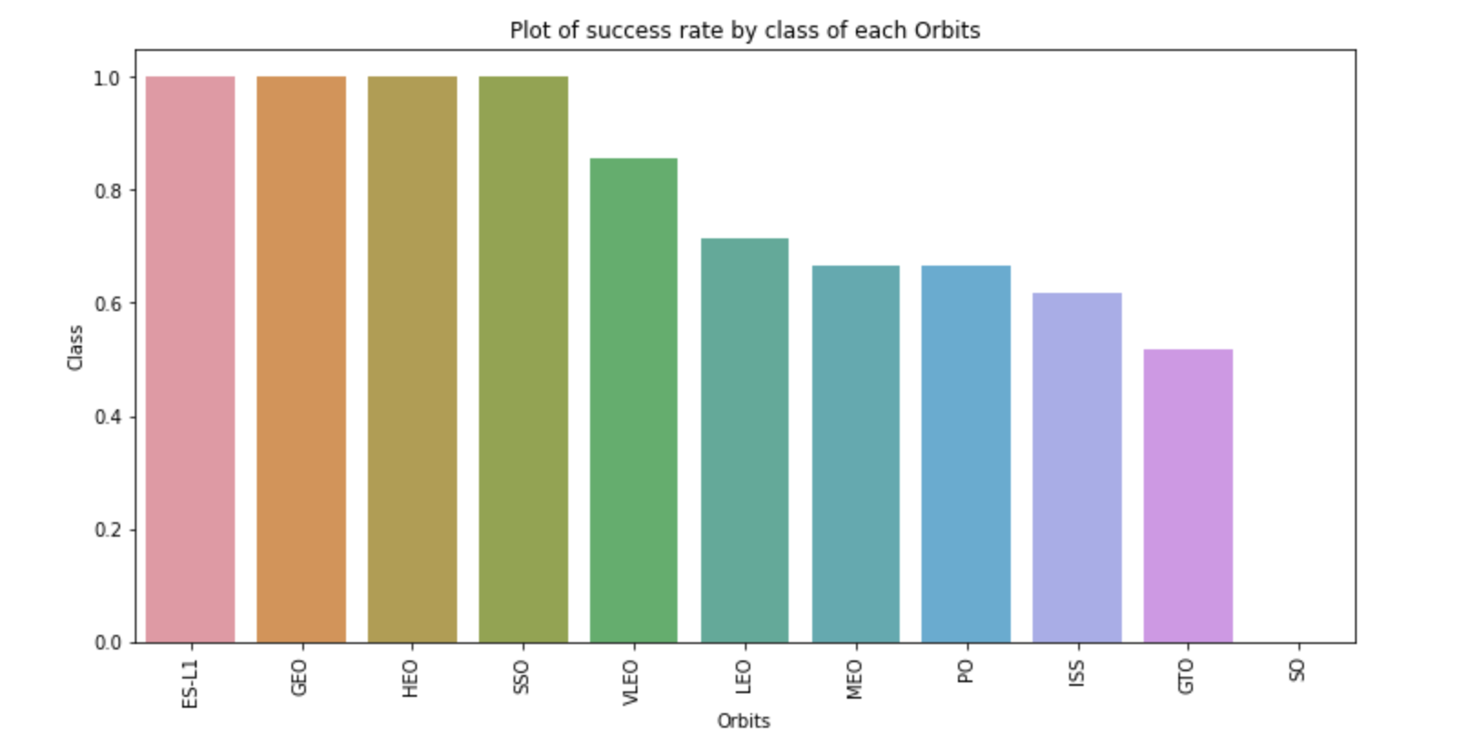
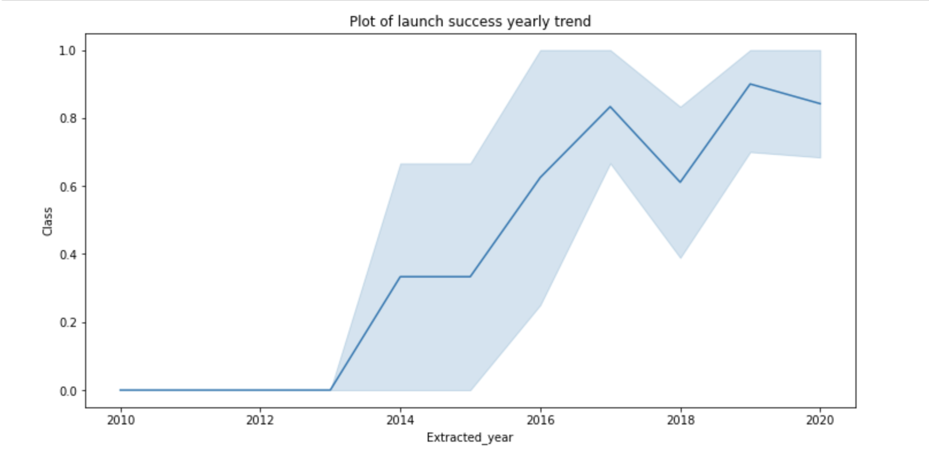
EDA with Data Visualization
We explored the data by visualizing the relationship between flight number and launch Site, payload and launch site, success rate of each orbit type, flight number and orbit type, the launch success yearly trend.
The link to the Notebook is https://github.com/FreddyR424/Capstone-Project-SpaceX/blob/master/jupyter-labs-eda-dataviz(1).ipynb

Slide 12

EDA with SQL
We loaded the SpaceX dataset into a PostgreSQL database without leaving the jupyter notebook.
We applied EDA with SQL to get insight from the data. We wrote queries to find out for instance:
The names of unique launch sites in the space mission.
The total payload mass carried by boosters launched by NASA (CRS)
The average payload mass carried by booster version F9 v1.1
The total number of successful and failure mission outcomes
The failed landing outcomes in drone ship, their booster version and launch site names.

Slide 13

Build an Interactive Map with Folium
We marked all launch sites, and added map objects such as markers, circles, lines to mark the success or failure of launches for each site on the folium map.
We assigned the feature launch outcomes (failure or success) to class 0 and 1: 0 for failure, and 1 for success.
Using the color-labeled marker clusters, we identified which launch sites havea relatively high success rate.
We calculated the distances between a launch-site to its proximities.
Are launch sites near railways, highways and coastlines.
Do launch sites keep certain distance away from cities.
The Link to the Notebook is https://github.com/FreddyR424/Capstone-Project-SpaceX/blob/master/lab_jupyter_launch_site_location(1).ipynb

Slide 14
Build a Dashboard with Plotly Dash
We built an interactive dashboard with Plotly dash
We plotted pie charts showing the total launches by a certain sites
We plotted scatter graph showing the relationship with Outcome and Payload Mass (Kg) for the different booster version.
The link to the Notebook is https://github.com/chuksoo/IBM-Data-Science-Capstone-SpaceX/blob/main/app.py

Slide 15
Predictive Analysis (Classification)
We loaded the data using numpy and pandas, transformed the data, split our data into training and testing.
We built different machine learning models and tune different hyperparameters using GridSearchCV.
We used accuracy as the metric for our model.
Improved the model using feature engineering and algorithm tuning.
We found the best performing classification model.
The link to the Notebook is https://github.com/FreddyR424/Capstone-Project-SpaceX/blob/master/SpaceX_Machine%20Learning%20Prediction_Part_5(1).ipynb

Slide 16

Results
Exploratory data analysis results
Interactive analytics demo in screenshots
Predictive analysis results

Slide 17

Section 2

Slide 18
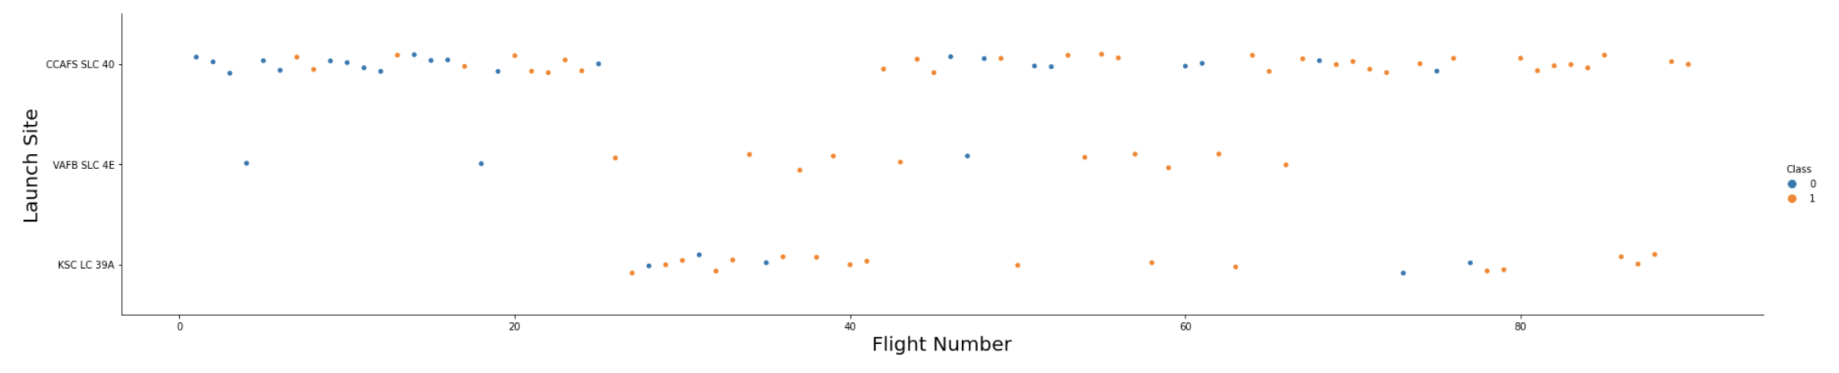
Flight Number vs. Launch Site
From the plot, we found that the larger the flight amount at a launch site, the greater the success rate at a launch site.

Slide 19
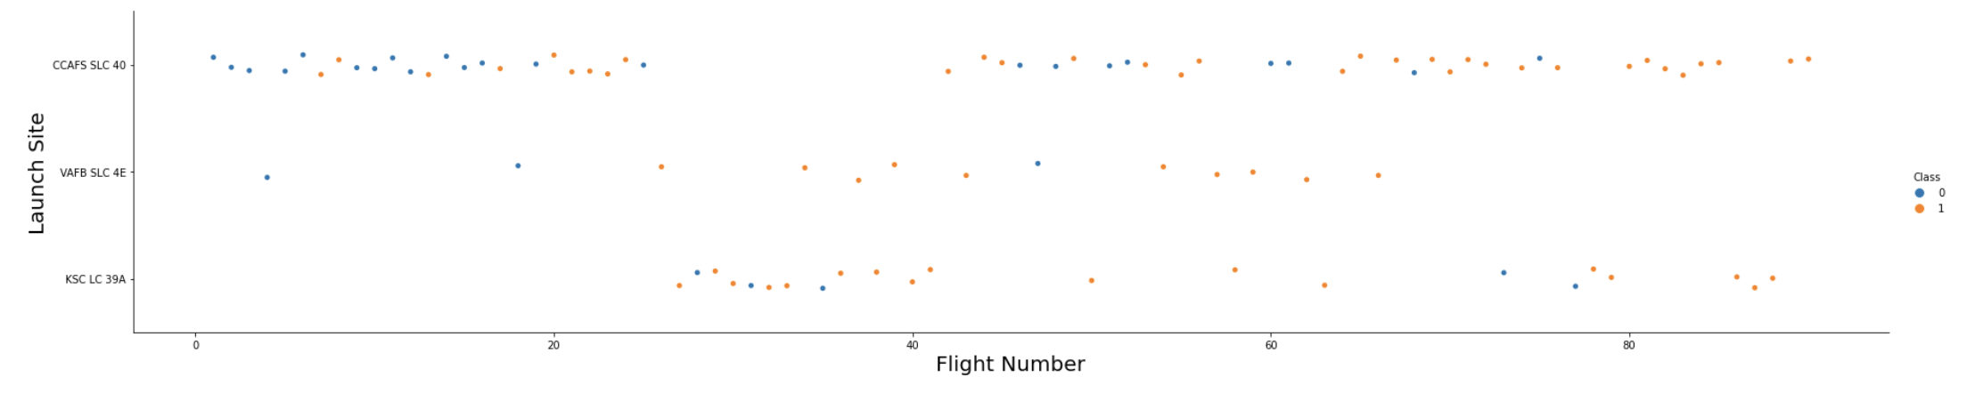
Payload vs. Launch Site
The Greater the Payload Mass for launch-site CCAFS SLC 40 the higher the success rate for the rocket.

Slide 20
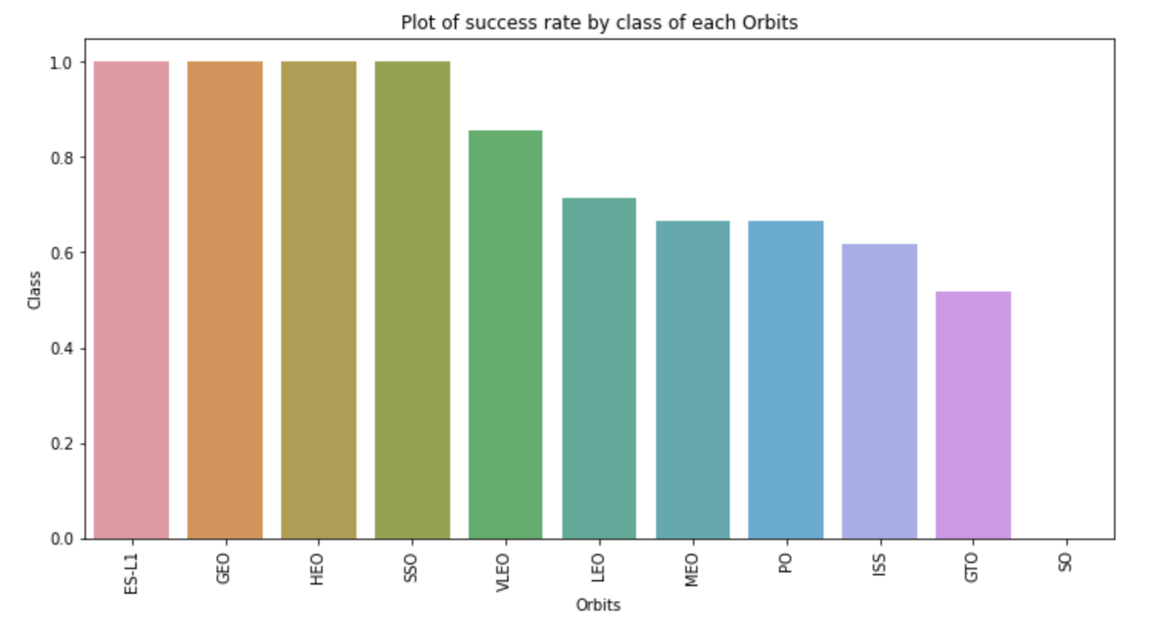
Success Rate vs. Orbit Type
From the plot, we can see that ES-L1, GEO, HEO, SSO, VLEO had the most success rate.

Slide 21
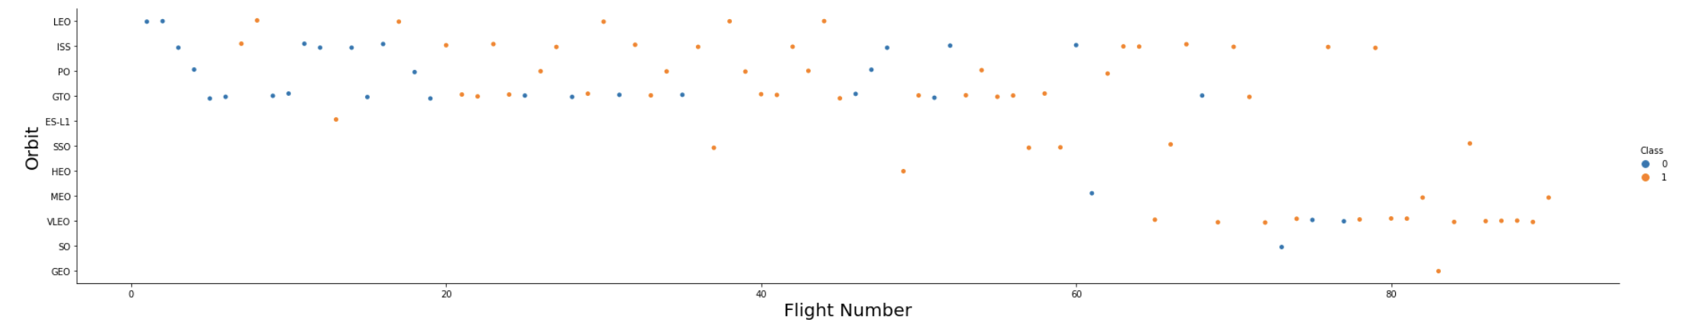
Flight Number vs. Orbit Type
The plot below shows the Flight Number vs. Orbit type. We observe that in the LEO orbit, success is related to the number of flights whereas in the GTO orbit, there is no relationship between flight number and the orbit.

Slide 22
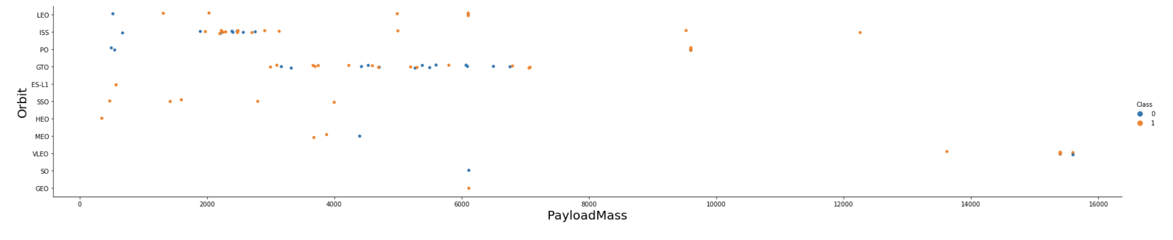
Payload vs. Orbit Type
We can observe that with heavy payloads, the successful landing are more for PO, LEO and ISS orbits.

Slide 23
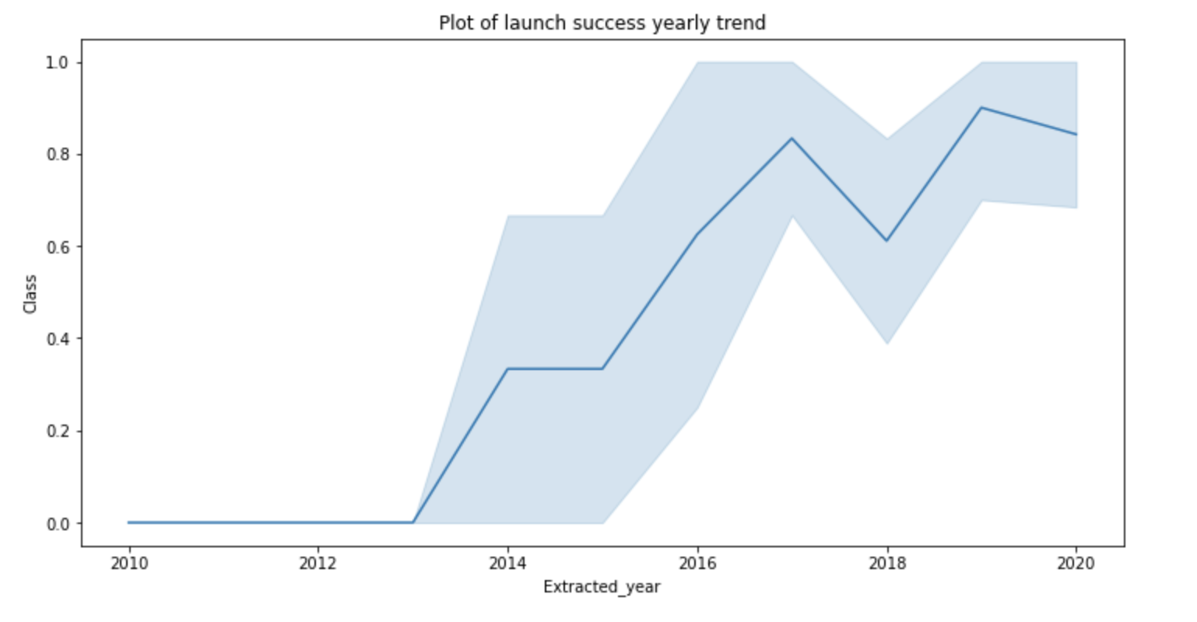
Launch Success Yearly Trend
From the plot, we can observe that success rate since 2013 kept on increasing till 2020.

Slide 24
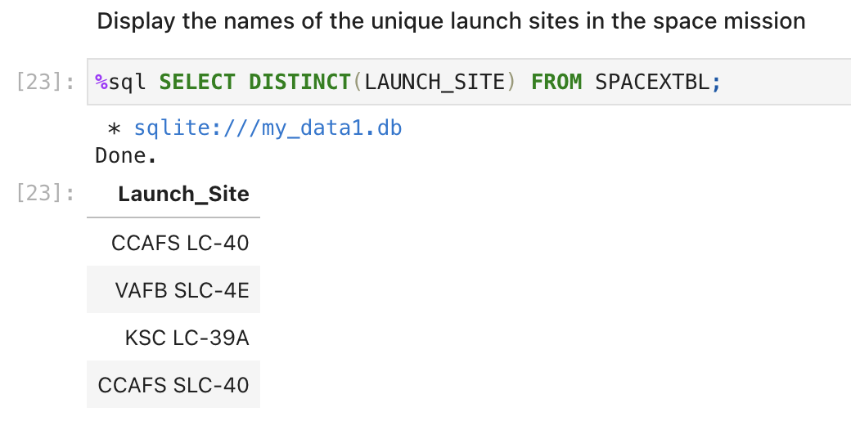
All Launch Site Names
We used the key word DISTINCT to show only unique launch sites from the SpaceX data.

Slide 25
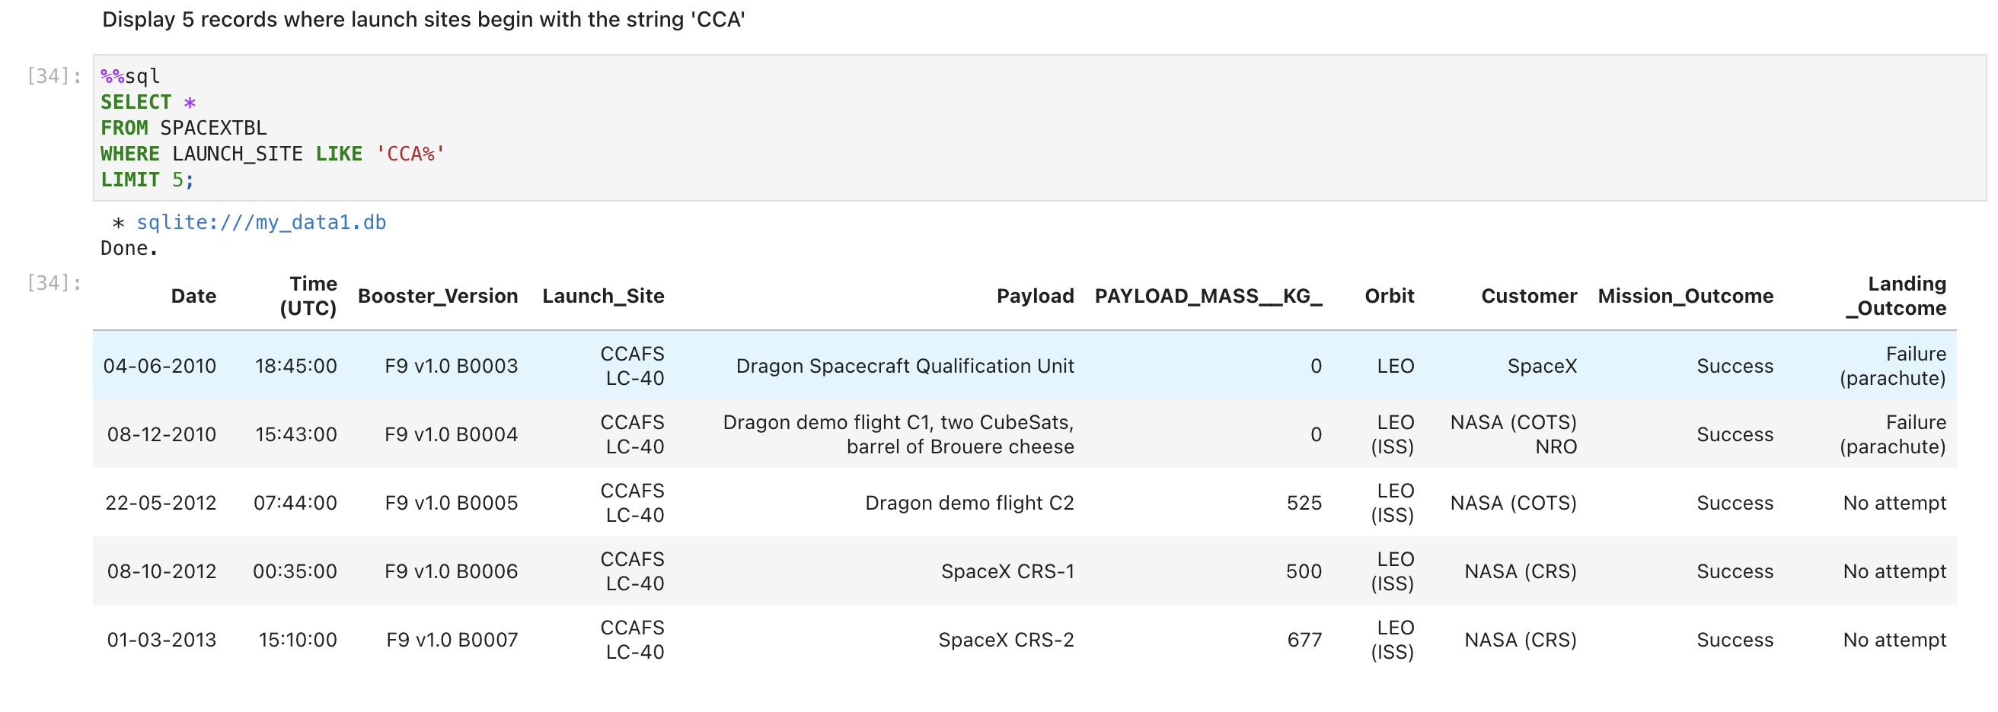
Launch Site Names Begin with 'CCA'
We used the query below to display 5 records where launch sites begin with `CCA`

Slide 26
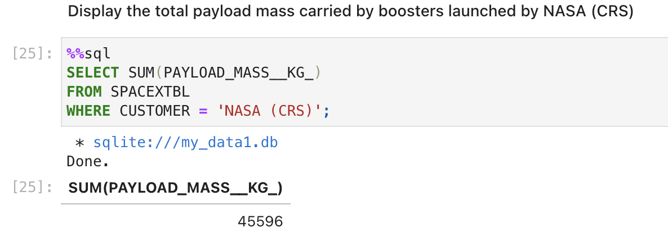
Total Payload Mass
We calculated the total payload carried by boosters from NASA as 45596 using the query below

Slide 27
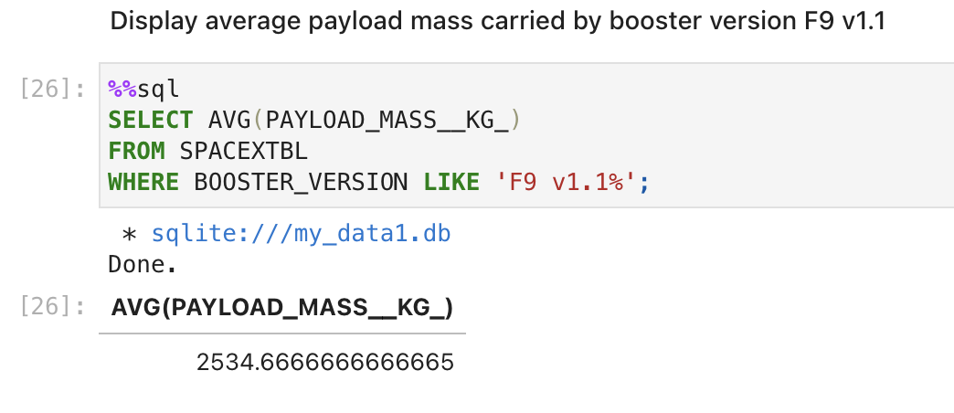
Average Payload Mass by F9 v1.1
We calculated the average payload mass carried by booster version F9 v1.1 as 2534.67

Slide 28
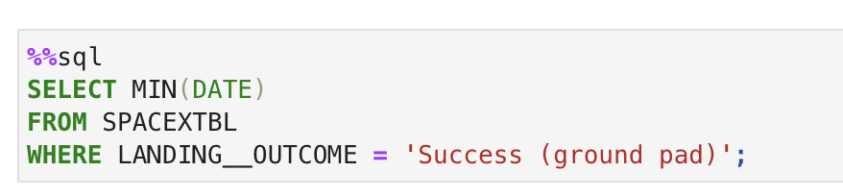

First Successful Ground Landing Date
We observed that the dates of the first successful landing outcome on ground pad was 22nd December 2015

Slide 29
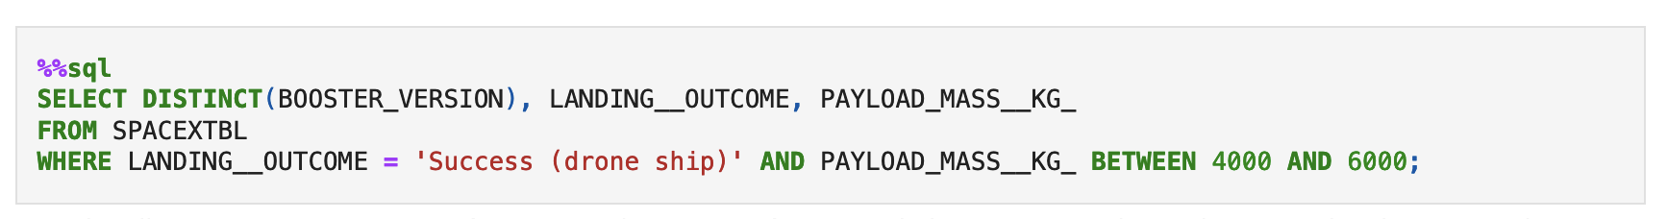
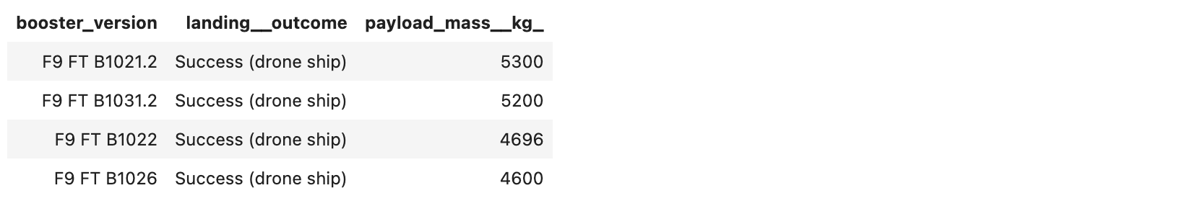
Successful Drone Ship Landing with Payload between 4000 and 6000
We used the WHERE clause to filter for boosters which have successfully landed on drone ship and applied the AND condition to determine successful landing with payload mass greater than 4000 but less than 6000

Slide 30
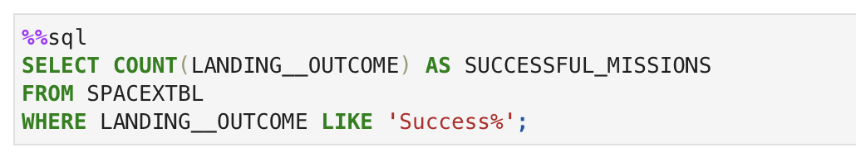
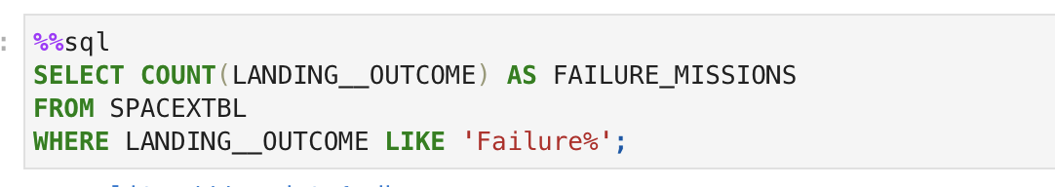
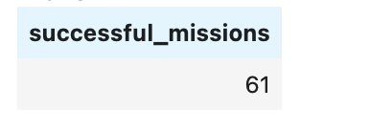
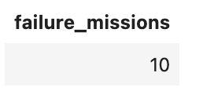
Total Number of Successful and Failure Mission Outcomes
We used wildcard like ‘%’ to filter for WHERE Mission Outcome was a success or a failure.

Slide 31
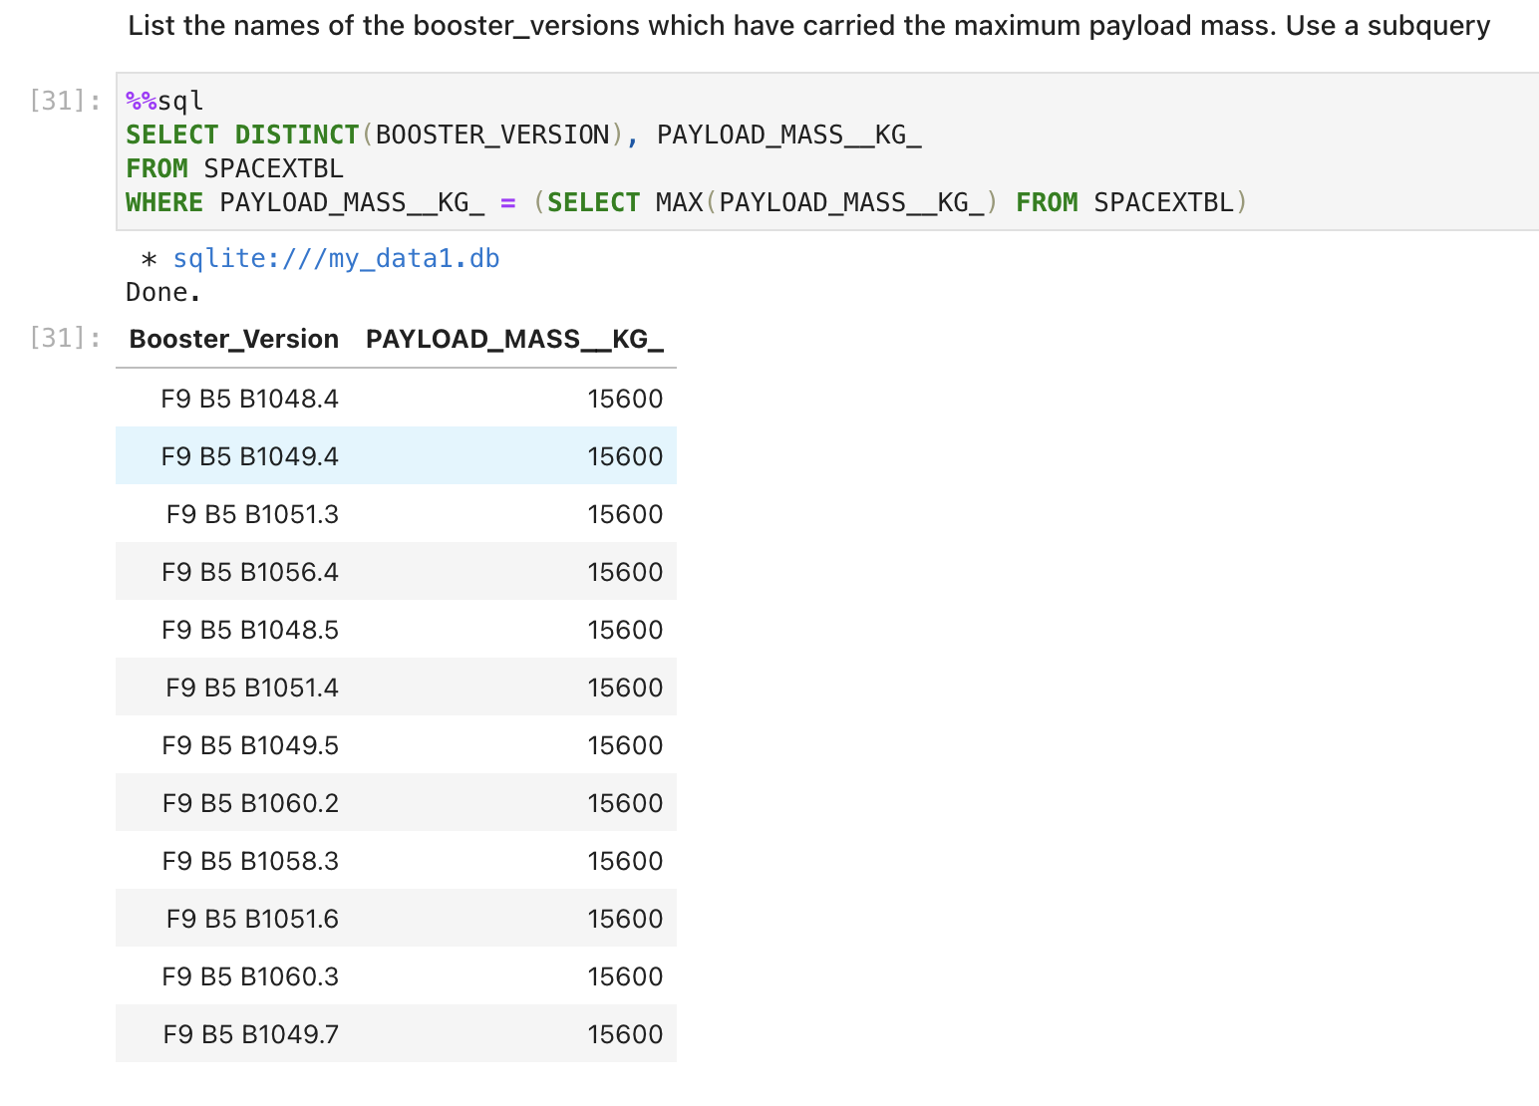
Boosters Carried Maximum Payload
We determined the booster that have carried the maximum payload using a subquery in the WHERE clause and the MAX() function.

Slide 32
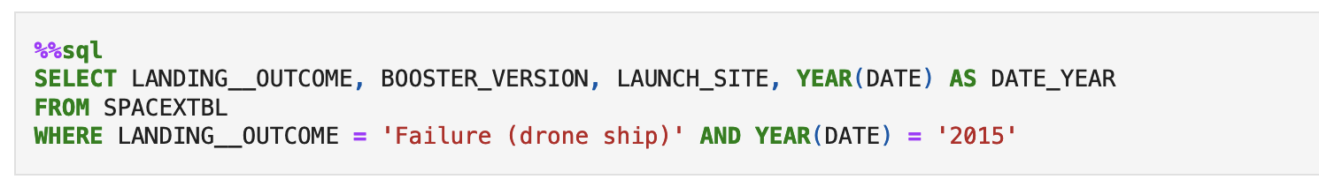
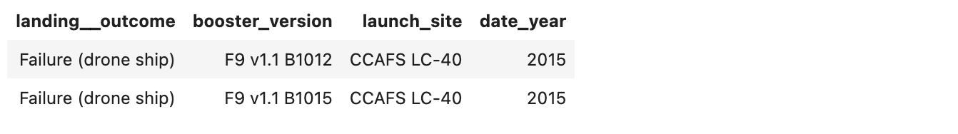
2015 Launch Records
We used a combinations of the WHERE clause, LIKE, AND, and BETWEEN conditions to filter for failed landing outcomes in drone ship, their booster versions, and launch site names for year 2015

Slide 33
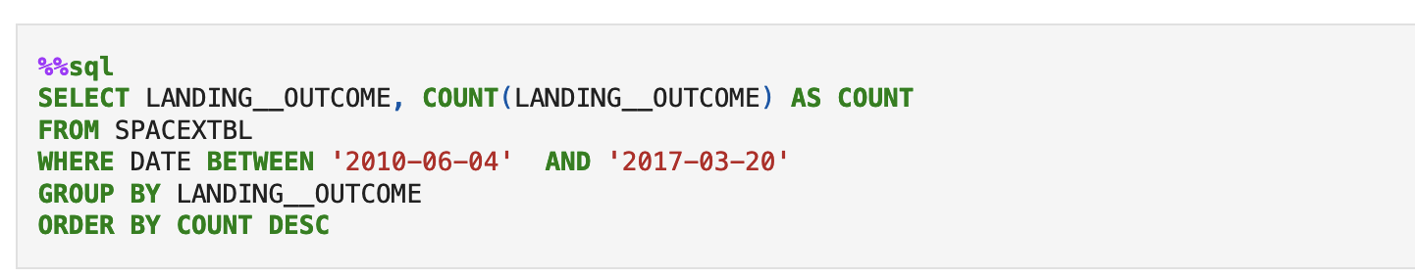
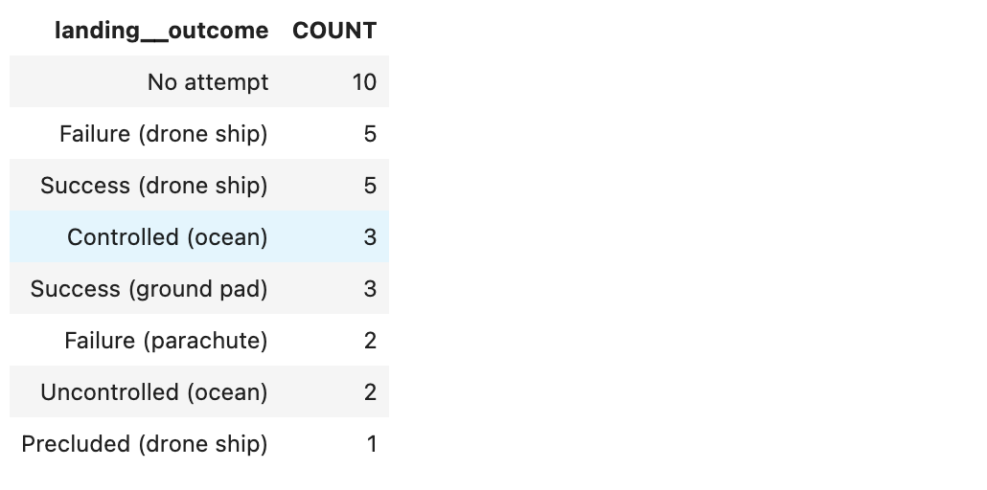
Rank Landing Outcomes Between 2010-06-04 and 2017-03-20
We selected Landing outcomes and the COUNT of landing outcomes from the data and used the WHERE clause to filter for landing outcomes BETWEEN 2010-06-04 to 2017-03-20.
We applied the GROUP BY clause to group the landing outcomes and the ORDER BY clause to order the grouped landing outcome in descending order.

Slide 34

Section 3

Slide 35
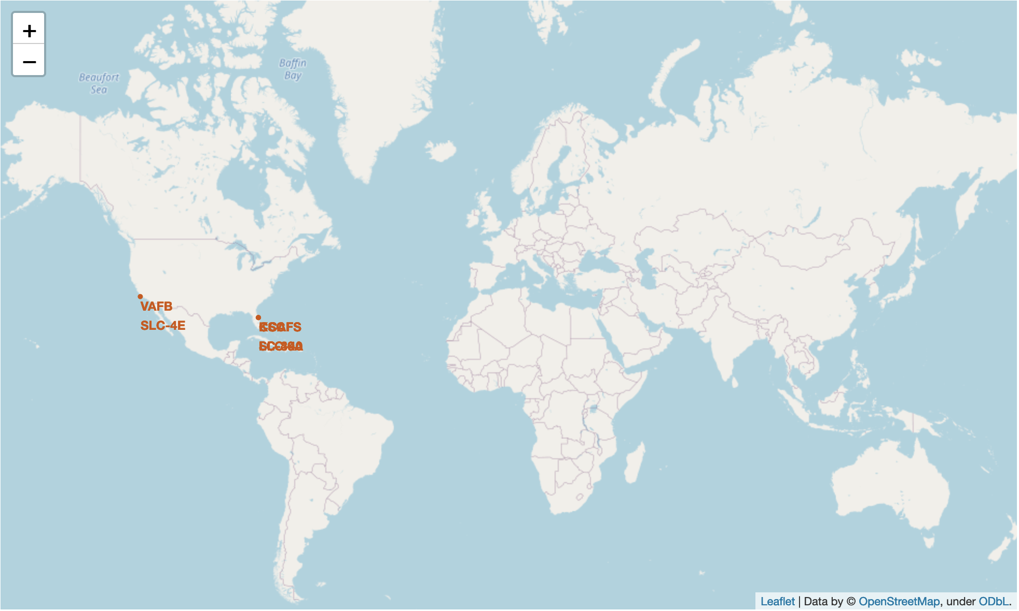
All SpaceX launch-sites on a Global Map
We can see here that SpaceX launch-sites are on the United States coastlines; in CA and FL

Slide 36

Markers showing launch-sites with color labels
Replace <Folium map screenshot 2> title with an appropriate title
Explore the folium map and make a proper screenshot to show the color-labeled launch outcomes on the map
Explain the important elements and findings on the screenshot

Slide 37

Launch-site distances to railways, highways, coastline, cities
Replace <Folium map screenshot 3> title with an appropriate title
Explore the generated folium map and show the screenshot of a selected launch site to its proximities such as railway, highway, coastline, with distance calculated and displayed
Explain the important elements and findings on the screenshot

Slide 38

Section 4

Slide 39

<Dashboard Screenshot 1>
Replace <Dashboard screenshot 1> title with an appropriate title
Show the screenshot of launch success count for all sites, in a piechart
Explain the important elements and findings on the screenshot

Slide 40

<Dashboard Screenshot 2>

Slide 41

<Dashboard Screenshot 3>

Slide 42

Section 5

Slide 43
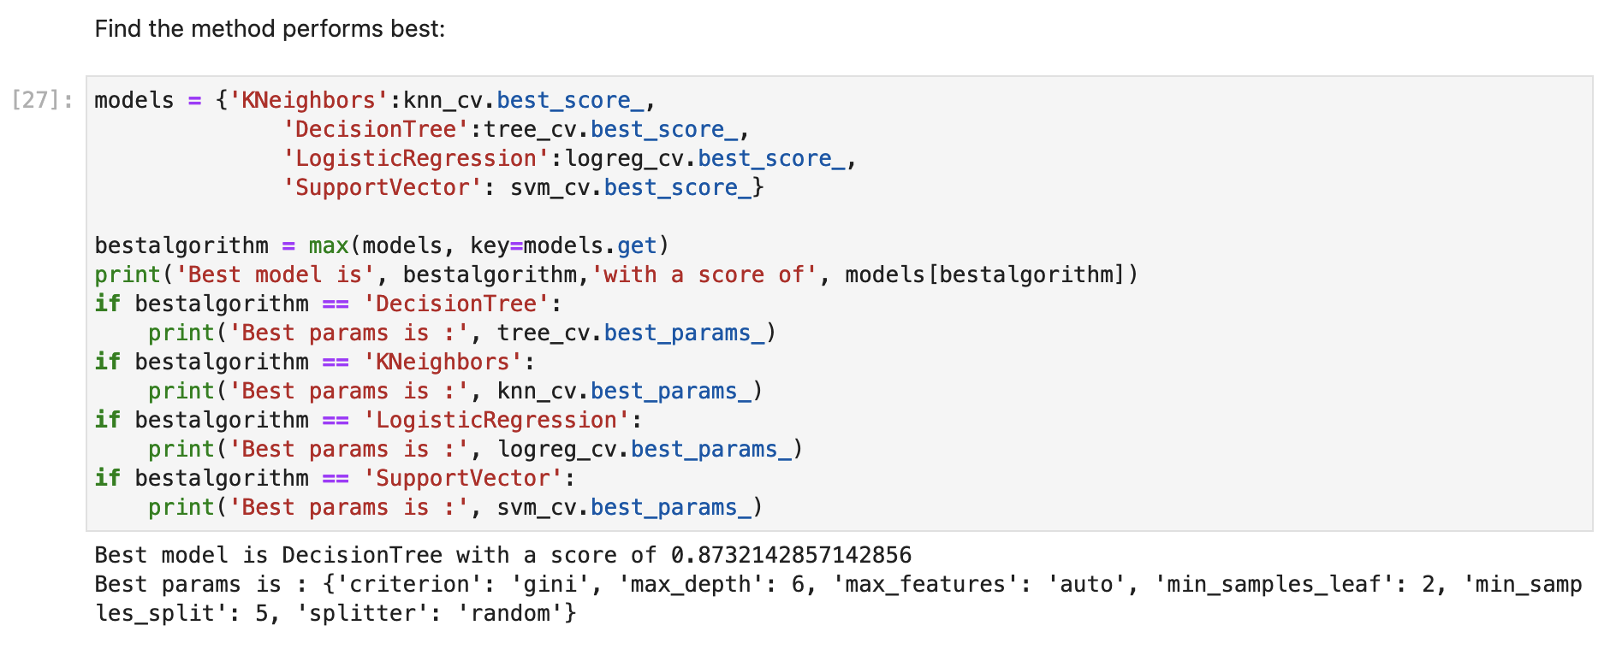
Classification Accuracy

Slide 44
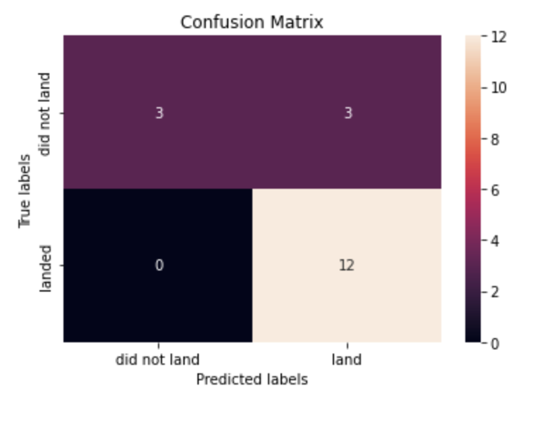
Confusion Matrix
The confusion matrix for the decision tree classifier shows that the classifier can distinguish between the different classes. The major problem is the false positives .i.e., unsuccessful landing marked as successful landing by the classifier.

Slide 45
Conclusions
We can conclude that:
The larger the flight amount at a launch site, the greater the success rate at a launch site.
Launch success rate started to increase in 2013 till 2020.
Orbits ES-L1, GEO, HEO, SSO, VLEO had the most success rate.
KSC LC-39A had the most successful launches of any sites.
The Decision tree classifier is the best machine learning algorithm for this task.

Slide 46


